Slide 1


Assignment No:02
Members:
Aliza Shareef 137
Shahzaib Abdul Qadir 150
Touqeer Zain 143

Slide 2
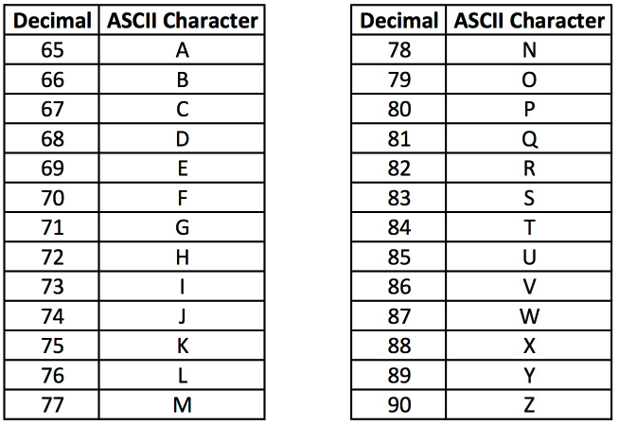
Step 1
Firstly we assign ASCII code to particular alphabet of msg
Lets suppose Message = “HELLO”
Assign ASCII value
Like
H = 72 E = 69 L = 76 L= 76 0=79

Slide 3
Step 2
Now break these ASCII value into 2 parts
Value = “ H = 72 E = 69 L = 76 L= 76 0=79 ”
H E L L 0
7 2 6 9 7 6 7 6 7 9
7 2 6 9 7 6 7 6 7 9
Add 30 in each number
So number = 37 , 32 , 36, 39, 37, 36, 37, 36, 37, 39

Slide 4
Step 3
Number = 37 , 32 , 36, 39, 37, 36, 37, 36, 37, 39
Add length of the key
Here our keyword is “HELLO”
SO, length is = 5 , add 5
Now these number becomes
New Number = 42,37,41,44,42,41,42,41,42,44

Slide 5
Step 4
New Number =42,37,41,44,42,41,42,41,42,44
Takes number 1 by 1 and create a 4 x 4 matrix which is shown in the table
Here our 1st num is = 47
So, plot the 4 X 4 just like that after plotting its horizontal addition or vertical addition is equal to 47
Raw1 = {27,1,12,7}
Raw2 ={11,8,19,2}
Raw3 ={5,10,3,29}
Raw4 ={4,28,6,9}
27 | 1 | 12 | 7
11 | 8 | 26 | 2
5 | 10 | 3 | 29
4 | 28 | 6 | 9
=47
=47
=47
=47
=47
=47
=47
=47

Slide 6
Mixed column
Raw1 = {27,1,12,7}
Raw2 ={11,8,19,2}
Raw3 ={5,10,3,29}
Raw4 ={4,28,6,9}
Here sort the value from the table now the raw number becomes the index number of the table
And then find the average
Here is the table :
["00",11,22,33,44,55,66,77,88,99],
["01",10,20,30,40,50,60,70,80,90],
["02",12,32,42,52,62,72,82,92,"09"],
["03",13,23,43,53,63,73,83,93,19],
["04",14,24,34,54,64,74,84,94,29],
["05",15,25,35,45,65,75,85,95,39],
["06",16,26,36,46,56,76,86,96,49],
["07",17,27,37,47,57,67,87,97,59],
["08",18,28,38,48,58,68,78,98,69],

Slide 7
After that combine the values and display the output
For decryption use these steps in recursive way so you can find your desired plane text.

Slide 8
Remind me in your precious prayers Thank you

